Slide 1
Session 5
NYU Stern Data Bootcamp
Spring 2023

Slide 2
Agenda
The internet
Browsers
HTML
Use cases

Slide 3



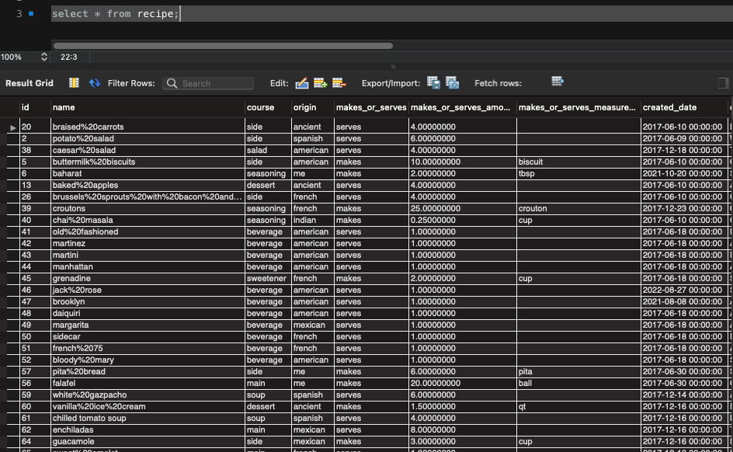
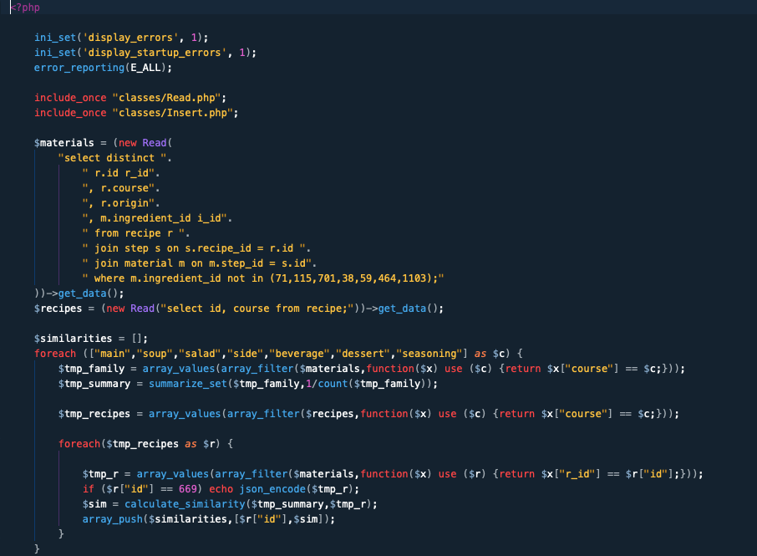
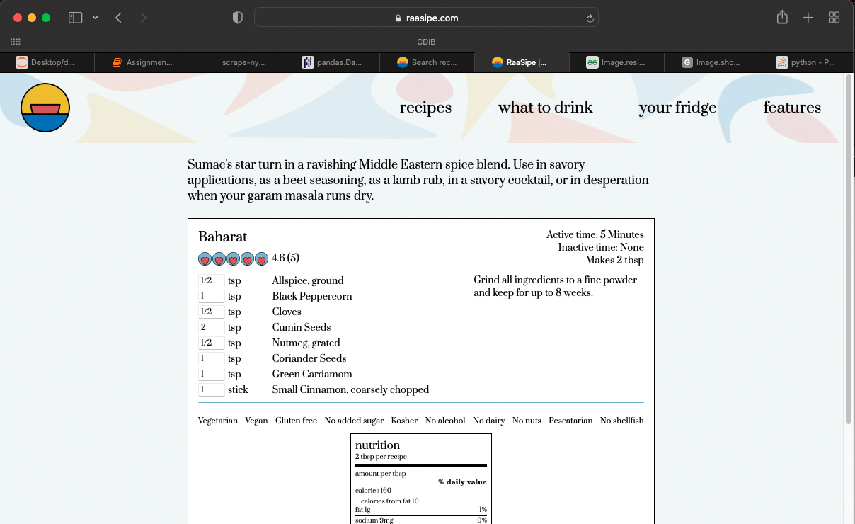
Everything on the internet is data
Databases
e.g., a SQL database
Servers
e.g., an AWS server
Clients
e.g., your laptop or phone

Slide 4
Everything on the internet is data
Databases
e.g., a SQL database
Servers
e.g., an AWS server
Clients
e.g., your laptop or phone
Databases store data used by websites
Examples:
Amazon product catalog
Walmart customer purchases
Kaplan Test Prep tutor list
Netflix episode list

Slide 5
Everything on the internet is data
Databases
e.g., a SQL database
Servers
e.g., an AWS server
Clients
e.g., your laptop or phone
Servers request and transform the data from databases
Examples:
Requesting relevant search results from Amazon product catalog
Requesting customer purchase history from Walmart database
Preparing Kaplan tutor list for display on sales website
Adding video previews to Netflix recommendation for a customer

Slide 6
Everything on the internet is data
Databases
e.g., a SQL database
Servers
e.g., an AWS server
Clients
e.g., your laptop or phone
Clients display server outputs and interact with users
Examples:
Displaying search results from the Amazon website
Showing users Walmart products and managing their shopping carts
Enabling Kaplan customers to book a tutoring session
Playing videos for Netflix customers

Slide 7
The internet is a two-way street
Databases
e.g., a SQL database
Servers
e.g., an AWS server
Clients
e.g., your laptop or phone
Clients communicate activities back to servers
Examples:
Booking an Amazon purchase
Logging a Walmart customer’s products of interest
Emailing a tutor that a customer has booked a session
Logging a customer’s position in a playing Netflix video

Slide 8
The internet is a two-way street
Databases
e.g., a SQL database
Servers
e.g., an AWS server
Clients
e.g., your laptop or phone
Servers save data to databases for later use
Examples:
Logging an Amazon customer’s purchase history for future recommendations
Saving a Walmart customer’s product review
Logging a Kaplan student’s course progress
Saving Netflix customers’ video catalogs and preferences

Slide 9
This one-way transformation is not directly reversible
Not accessible to you
Accessible to you
Databases
e.g., a SQL database
Servers
e.g., an AWS server
Clients
e.g., your laptop or phone

Slide 10
The goal of web scraping is to reverse this transformation with coding techniques
Databases
e.g., a SQL database
Servers
e.g., an AWS server
Clients
e.g., your laptop or phone
Scraped data
e.g., Amazon reviews

Slide 11
Agenda
The internet
Browsers
HTML
Use cases

Slide 12




Browsers interact with four technologies
Not available to client
Not typically used in web scraping
Used in web scraping
PHP
Server programming language
JavaScript
Client programming language
CSS
Applies styles to webpages
HTML
Specifies webpage content

Slide 13
How does the client use what it receives from the server?
Databases
e.g., a SQL database
Servers
e.g., an AWS server
Clients
e.g., your laptop or phone
What exactly happens here to turn server inputs into displayed webpages?

Slide 14
Case 1: good for web scraping
Databases
e.g., a SQL database
Servers
e.g., an AWS server
Clients
e.g., your laptop or phone
The server returns HTML and / or PHP, which are directly executed to create the webpage

Slide 15
Case 2: harder for web scraping
Databases
e.g., a SQL database
Servers
e.g., an AWS server
Clients
e.g., your laptop or phone
The server returns some HTML and PHP, which are directly executed, but the client is also required to execute JavaScript code, which happens only in the browser

Slide 16
Case 3: hardest for web scraping
Databases
e.g., a SQL database
Servers
e.g., an AWS server
Clients
e.g., your laptop or phone
The server returns some HTML and PHP which are directly executed, but also requires login credentials and access tokens, which we are used to managing with browser identity tools

Slide 17
Agenda
The internet
Browsers
HTML
Use cases

Slide 18
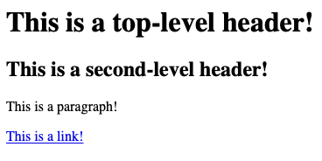

HTML is a markup language
Raw, marked-up document
Client-interpreted display

Slide 19
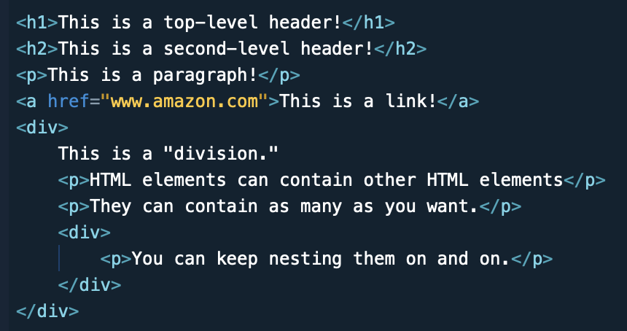
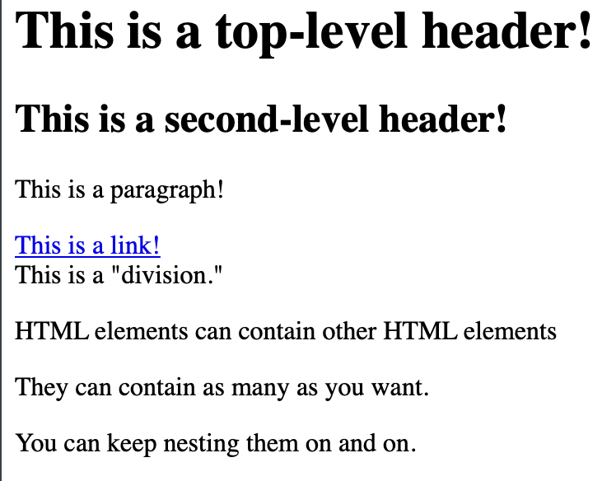
HTML elements can contain other HTML elements
You can nest HTML elements like dicts
The display doesn’t always reflect this

Slide 20
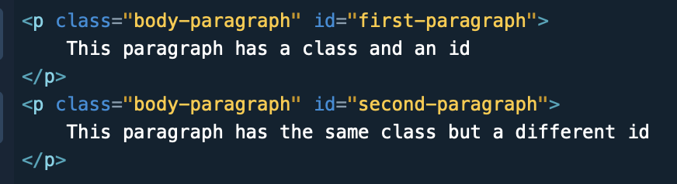
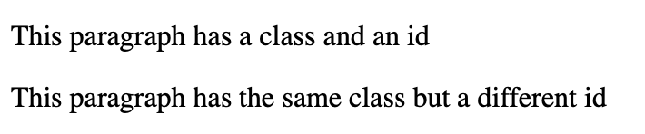
Attributes: classes, ids, etc
HTML elements get attributes
No style difference unless you make one
We will use these attributes to guide scraping

Slide 21
Example: recipe site
Databases
SQL database containing structured recipe data
Servers
e.g., an AWS server
Clients
e.g., your laptop or phone
id | name | course | origin | makes_or_serves | makes_or_serves_amount | makes_or_serves_measure_id | ratings_count | review_sum_of_1_to_5_ratings
20 | braised%20carrots | side | ancient | serves | 4 |  | 0 | 0
2 | potato%20salad | side | spanish | serves | 6 |  | 5 | 25
38 | caesar%20salad | salad | american | serves | 4 |  | 13 | 61
5 | buttermilk%20biscuits | side | american | makes | 10 | biscuit | 0 | 0
6 | baharat | seasoning | me | makes | 2 | tbsp | 5 | 23
13 | baked%20apples | dessert | ancient | serves | 4 |  | 0 | 0
26 | brussels%20sprouts%20with%20bacon%20and%20cheese | side | french | serves | 4 |  | 0 | 0
39 | croutons | seasoning | french | makes | 25 | crouton | 0 | 0
40 | chai%20masala | seasoning | indian | makes | 0.25 | cup | 0 | 0
41 | old%20fashioned | beverage | american | serves | 1 |  | 0 | 0
42 | martinez | beverage | american | serves | 1 |  | 0 | 0

Slide 22
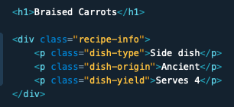
Example: recipe site
Databases
SQL database containing structured recipe data
Servers
e.g., an AWS server
Clients
e.g., your laptop or phone
Code on the server consumes the data from the database and composes HTML code
id | name | course | origin | makes_or_serves | makes_or_serves_amount
20 | braised%20carrots | side | ancient | serves | 4

Slide 23
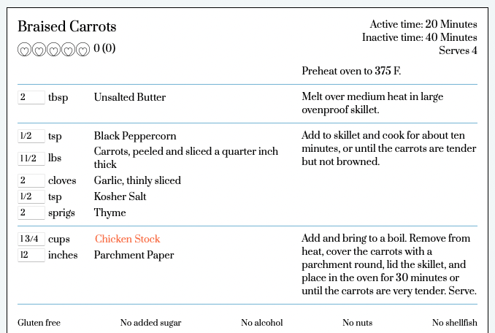
Example: recipe site
Databases
SQL database containing structured recipe data
Servers
e.g., an AWS server
Clients
e.g., your laptop or phone

Slide 24
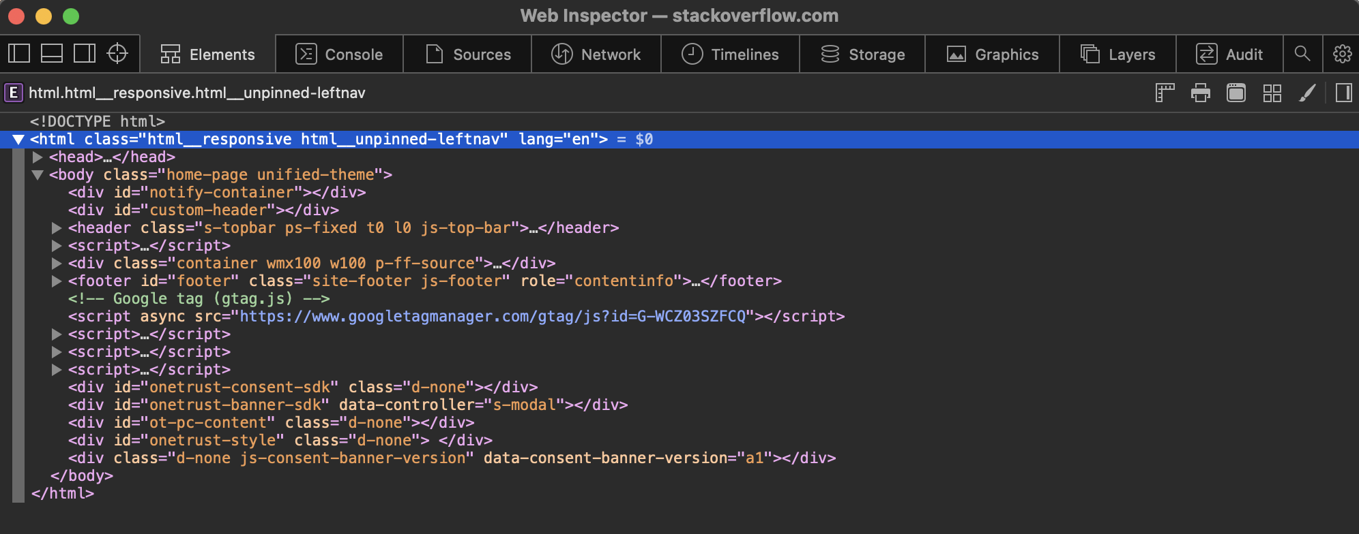
Browsers come equipped with developer tools, which are usually hidden by default

Slide 25
”Elements” refers to the HTML elements on the page

Slide 26
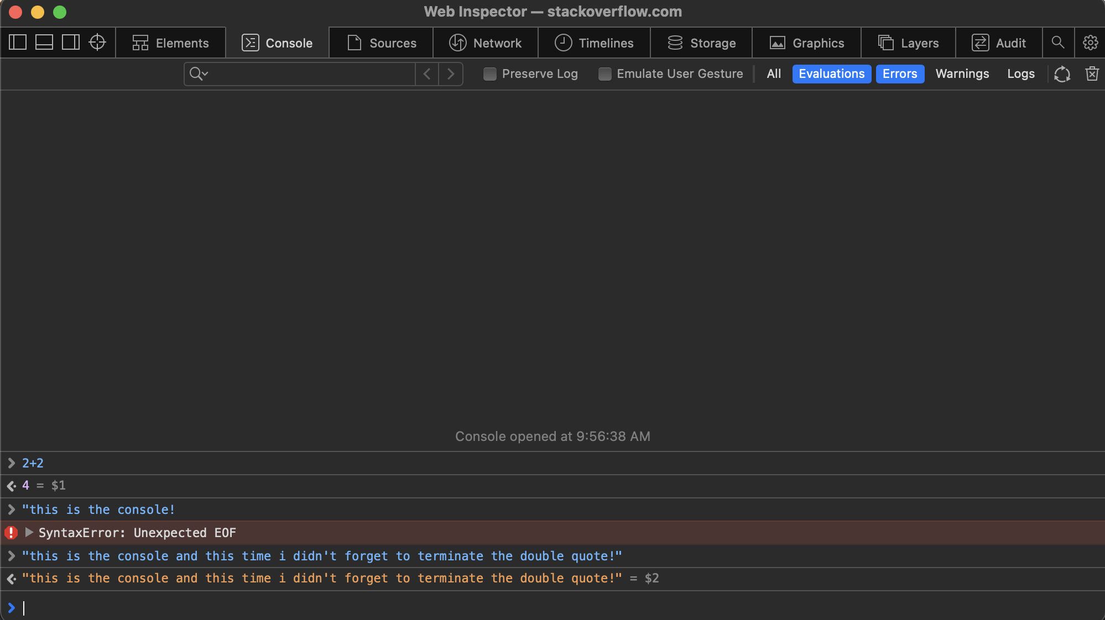
”Console” is where errors and messages are logged; you can also directly execute JavaScript code here

Slide 27
This other stuff we will mostly not need

Slide 28
Agenda
The internet
Browsers
HTML
Use cases

Slide 29
Bain & Co – advising a medical devices company on SKU rationalization

Slide 30
Kaplan Test Prep – market research on LMS systems using Capterra

Slide 31
Job interview – scraping tutors from several popular international language tutoring services

